Slide 1
Australian insights on income dynamics from administrative data (2002-2022)
GRID Project Update
Matt Elias
08/11/2024

Slide 2
Introduction

Slide 3
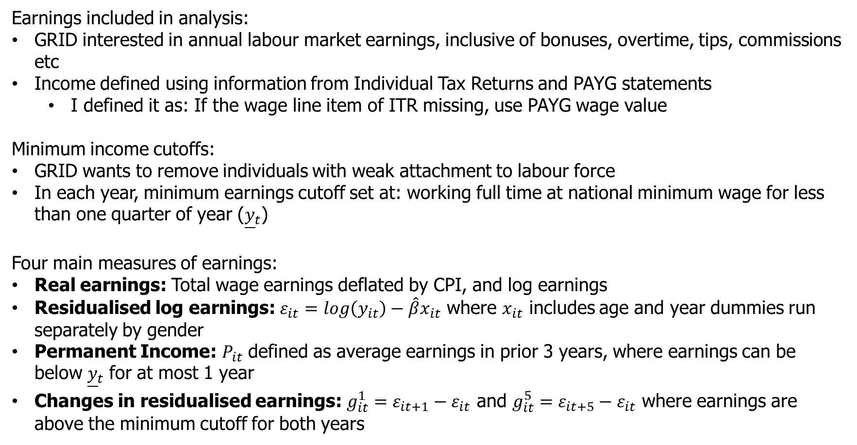
Variable construction
Earnings included in analysis:
GRID interested in annual labour market earnings, inclusive of bonuses, overtime, tips, commissions etc
Income defined using information from Individual Tax Returns and PAYG statements
I defined it as: If the wage line item of ITR missing, use PAYG wage value
Minimum income cutoffs:
GRID wants to remove individuals with weak attachment to labour force
In each year, minimum earnings cutoff set at: working full time at national minimum wage for less than one quarter of year (${\underline{y}}_{t}$)
Four main measures of earnings:
Real earnings: Total wage earnings deflated by CPI, and log earnings
Residualised log earnings: $ε_{it}=log\left(y_{it}\right)−\hat{β}x_{it}$ where $x_{it}$ includes age and year dummies run separately by gender
Permanent Income: $P_{it}$ defined as average earnings in prior 3 years, where earnings can be below ${\underline{y}}_{t}$ for at most 1 year
Changes in residualised earnings: $g_{it}^{1}=ε_{it+1}−ε_{it}$ and $g_{it}^{5}=ε_{it+5}−ε_{it}$ where earnings are above the minimum cutoff for both years

Slide 4
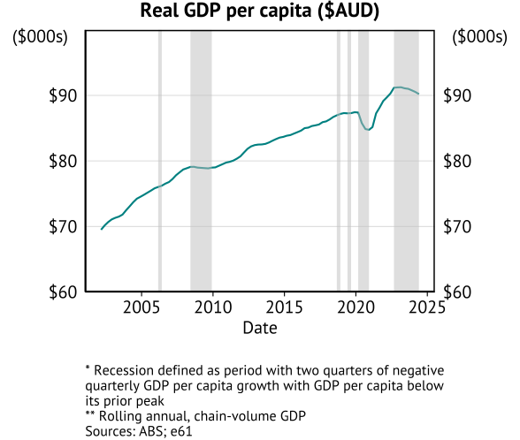
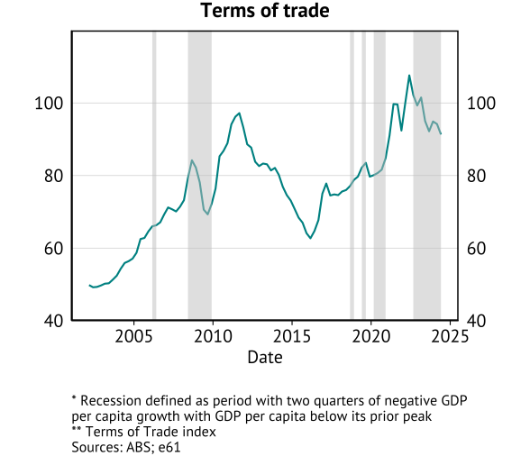
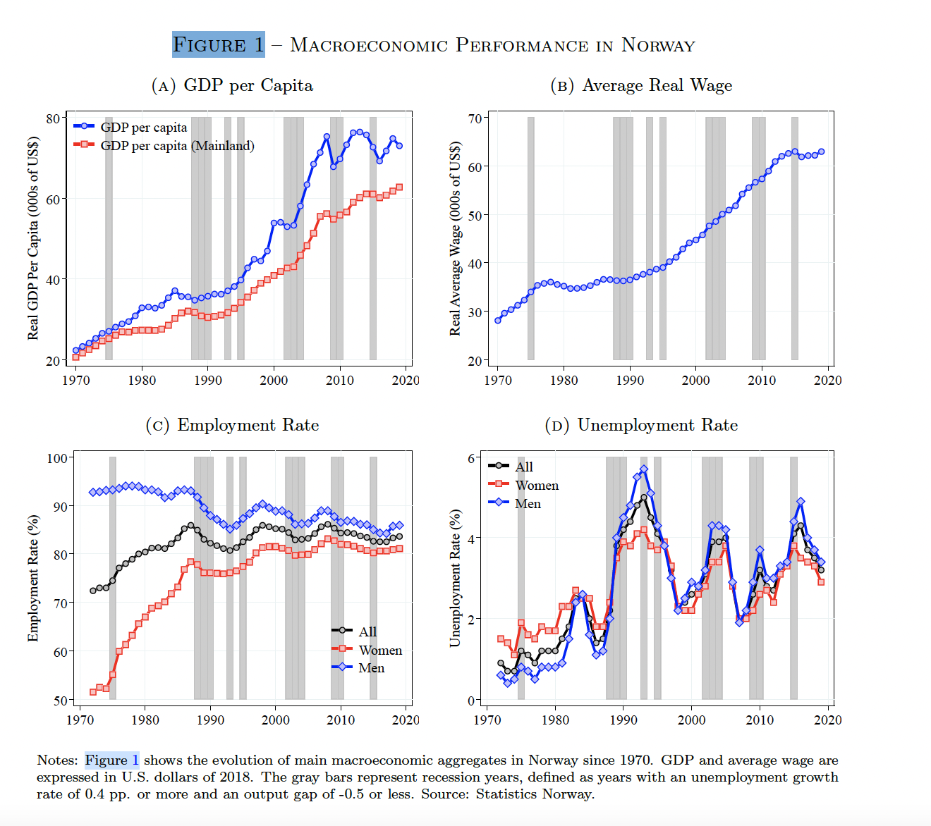
Macroeconomic performance
Australian macro context:
Only one “GDP recession” in 30 years (population growth)
End of mining boom (post-2012)

Slide 5
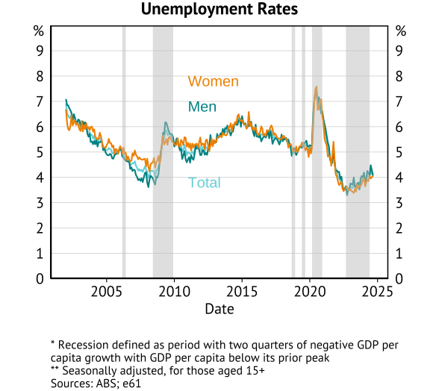
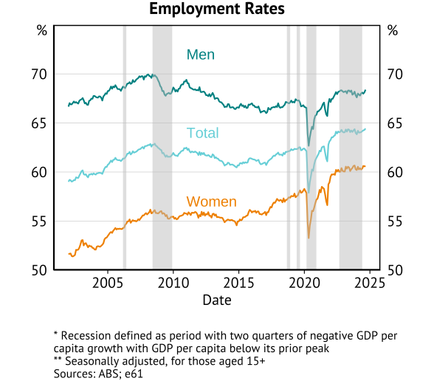
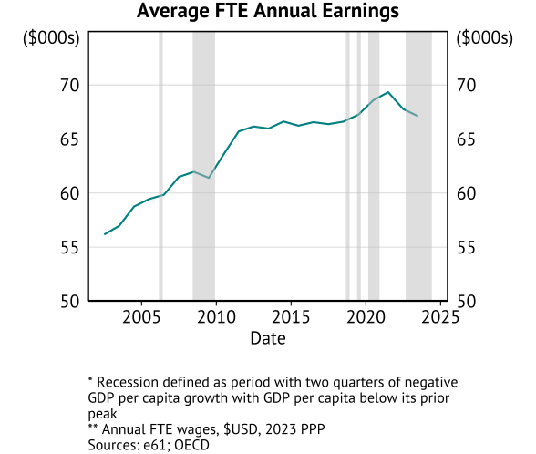
Macroeconomic performance

Slide 6

Australia microdata and specific coding issues
Bottom coding:
Occurs due to non-filing of tax returns below the tax-free threshold.
Use PAYG data (jobs file) as primary source to address this in part.
Top coding:
Values above an earnings level are censored by the ABS.
Top coded value changes depending on variable and changes across different years.
Datalab recommendations is to only release data based on top coding at a nominal $1 million per job per year.
Total taxable income top coded to $6 million pa.
Data structure

Slide 7
Inequality

Slide 8
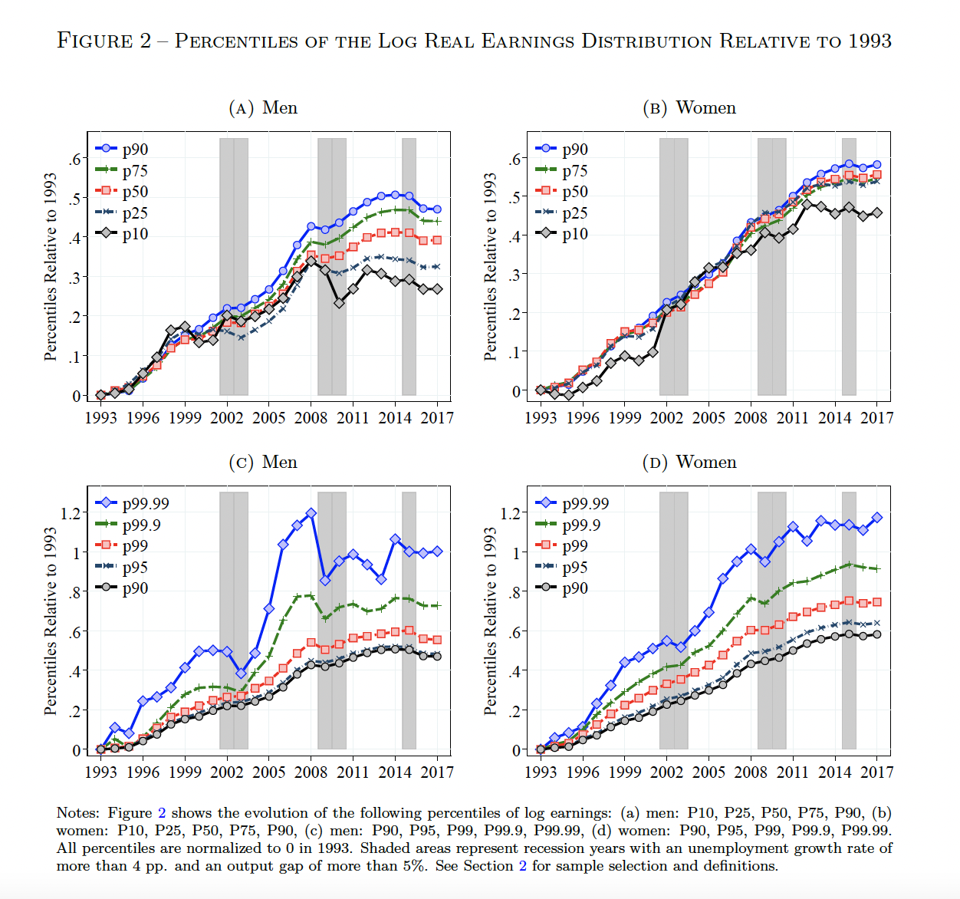
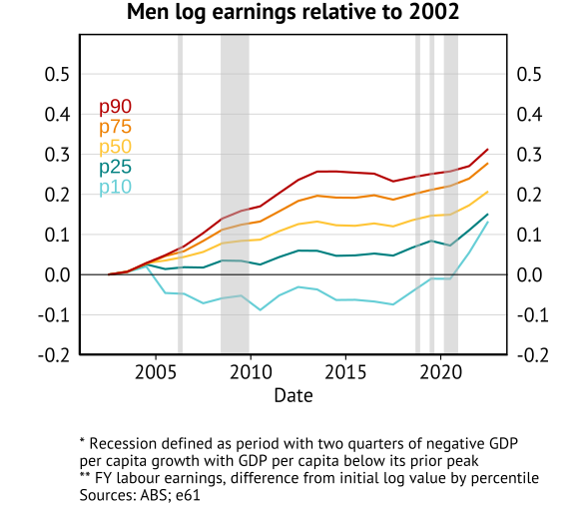
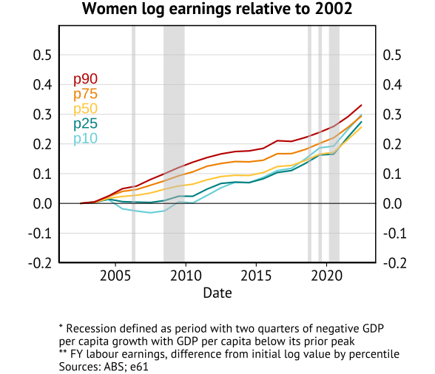
Percentiles of the Log Real Earnings Distribution relative to 2002

Slide 9
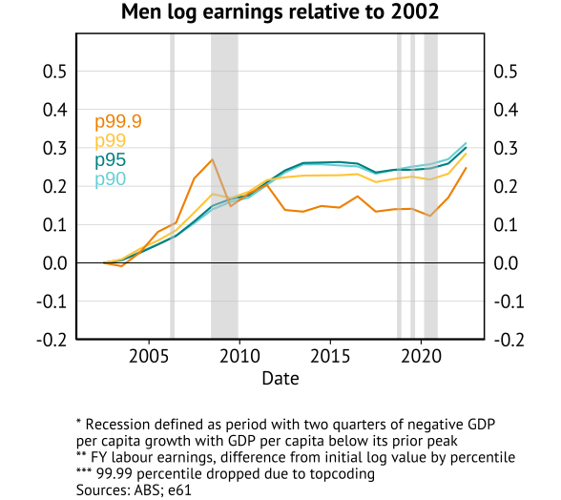
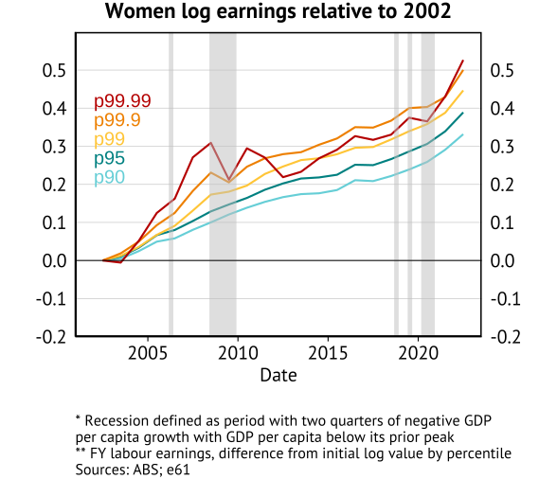
Percentiles of the Log Real Earnings Distribution relative to 2002

Slide 10
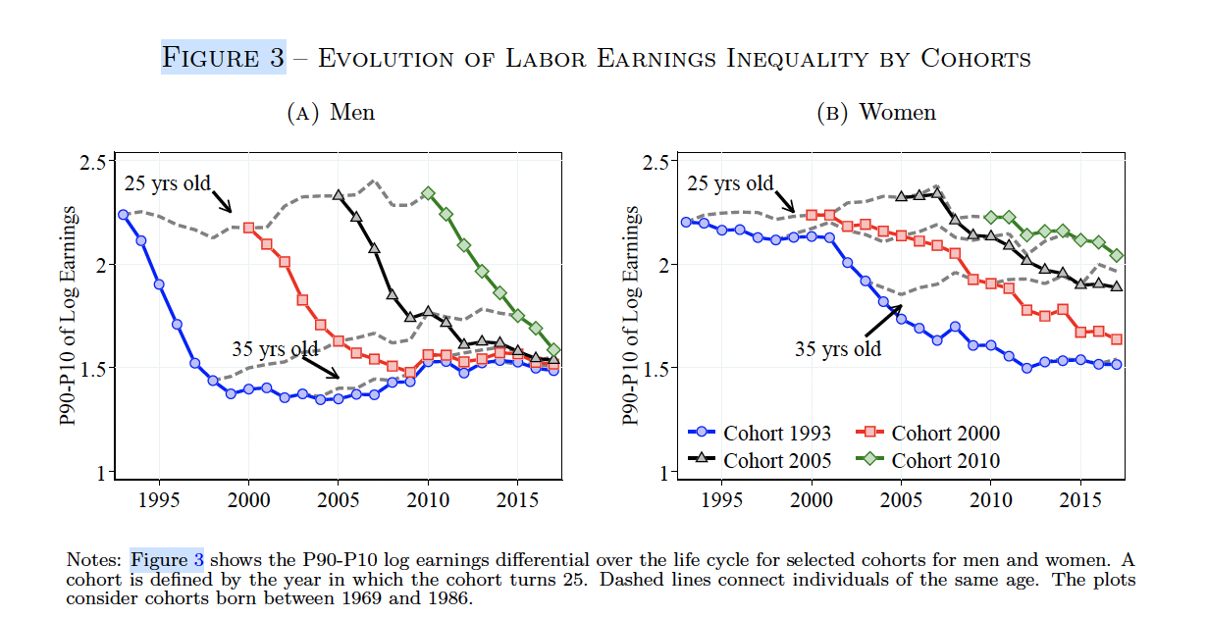
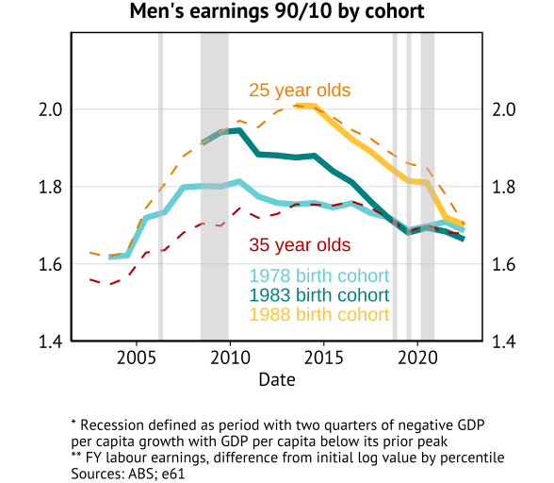
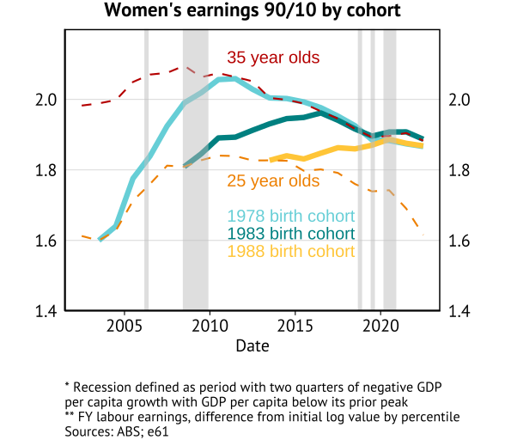
Evolution of Labour Earnings Inequality by Cohort

Slide 11
Volatility

Slide 12
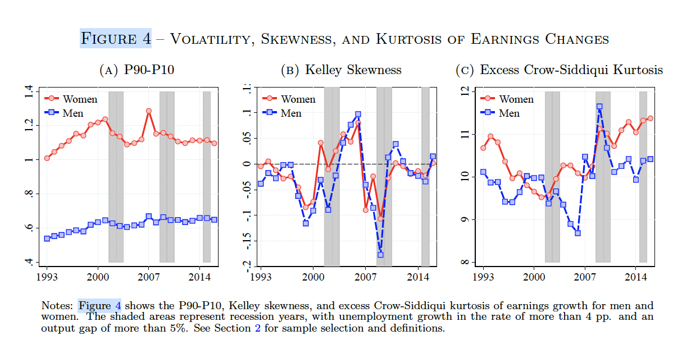
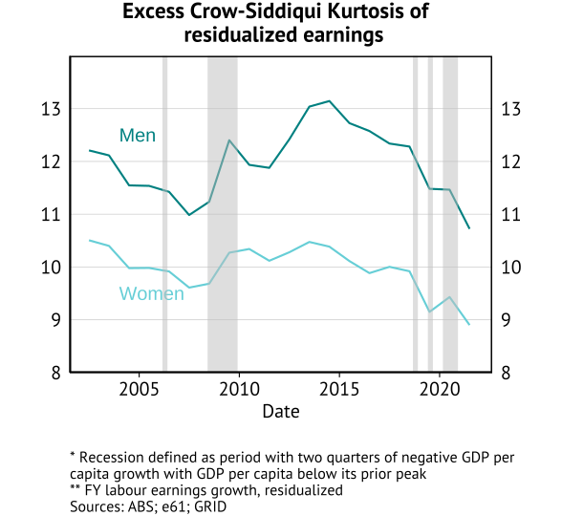
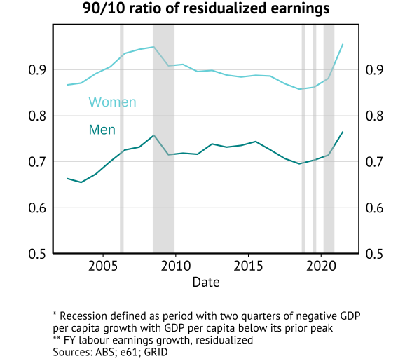
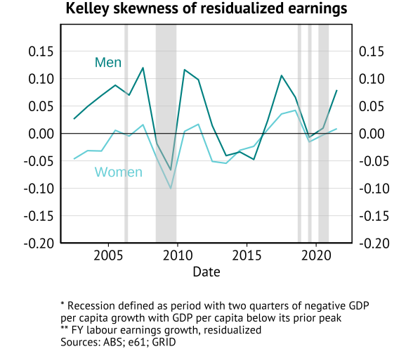
Distribution of one-year growth of residualized earnings

Slide 13
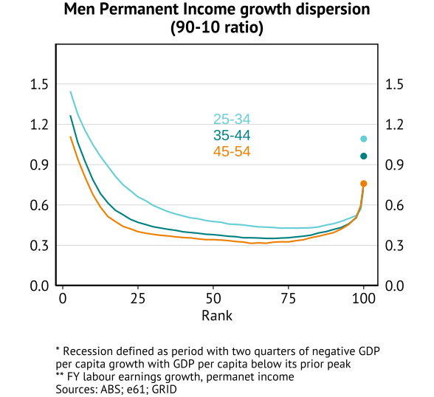
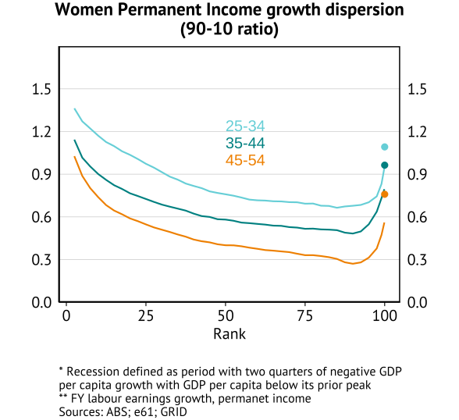
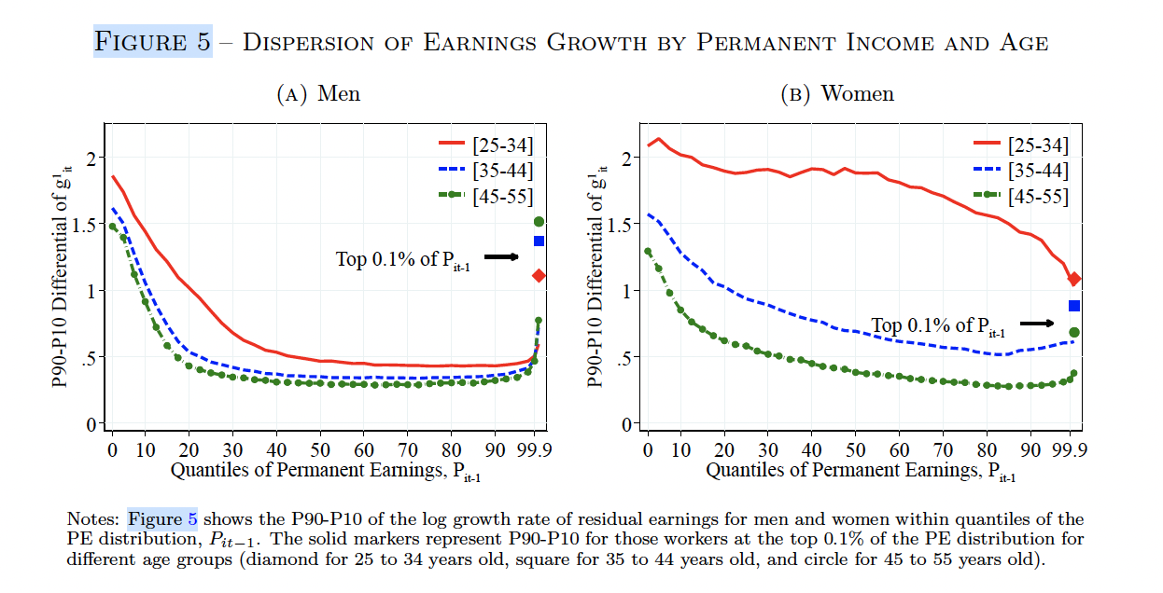
One-year growth of residualised earnings by permanent income

Slide 14
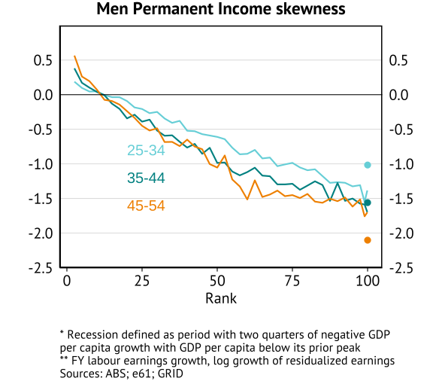
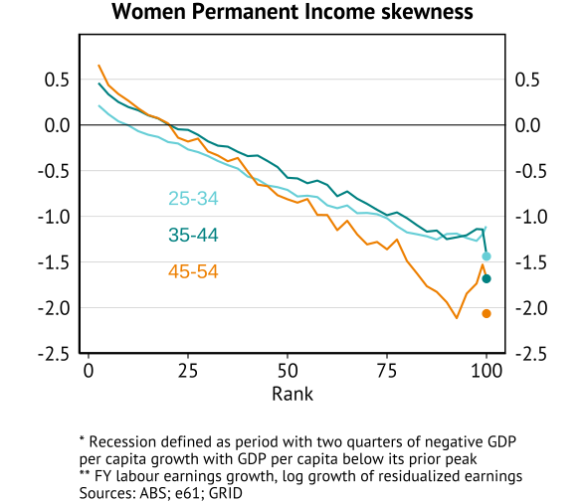
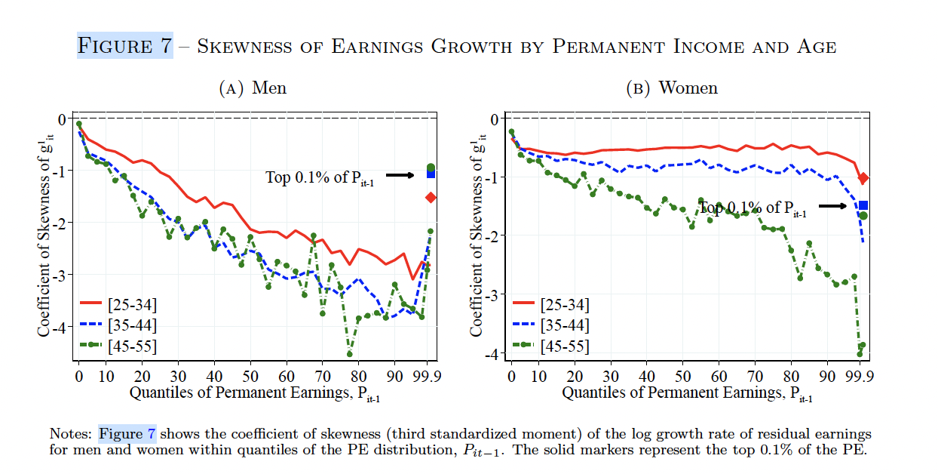
One-year growth of residualised earnings by permanent income

Slide 15
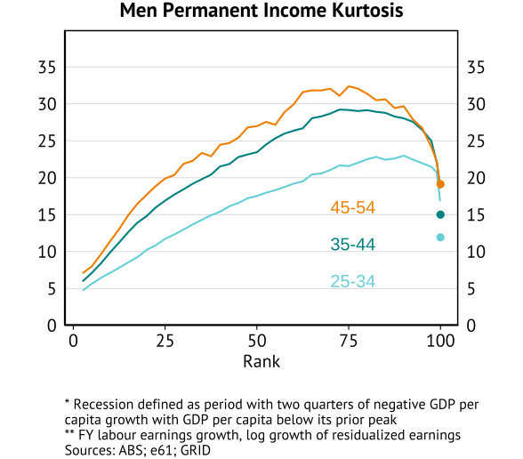
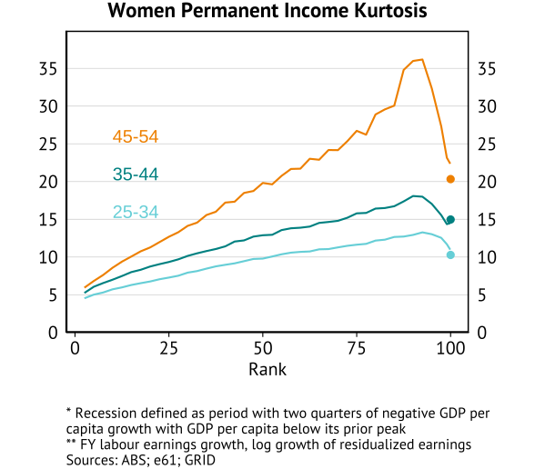
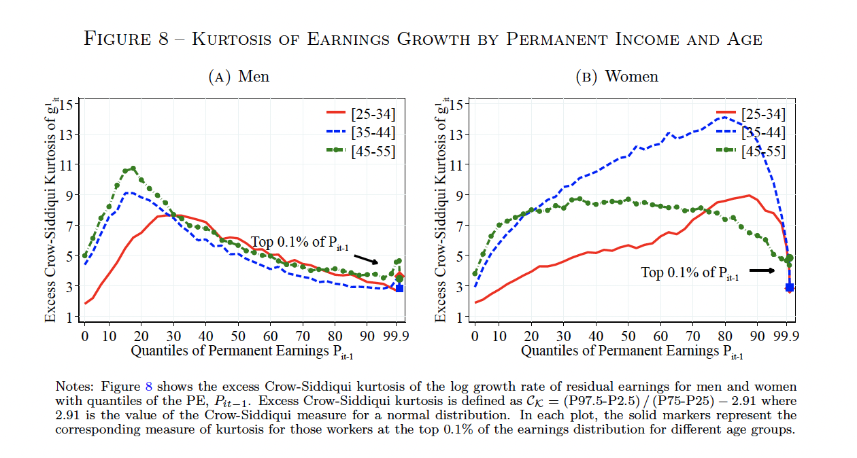
One-year growth of residualised earnings by permanent income

Slide 16
Mobility

Slide 17
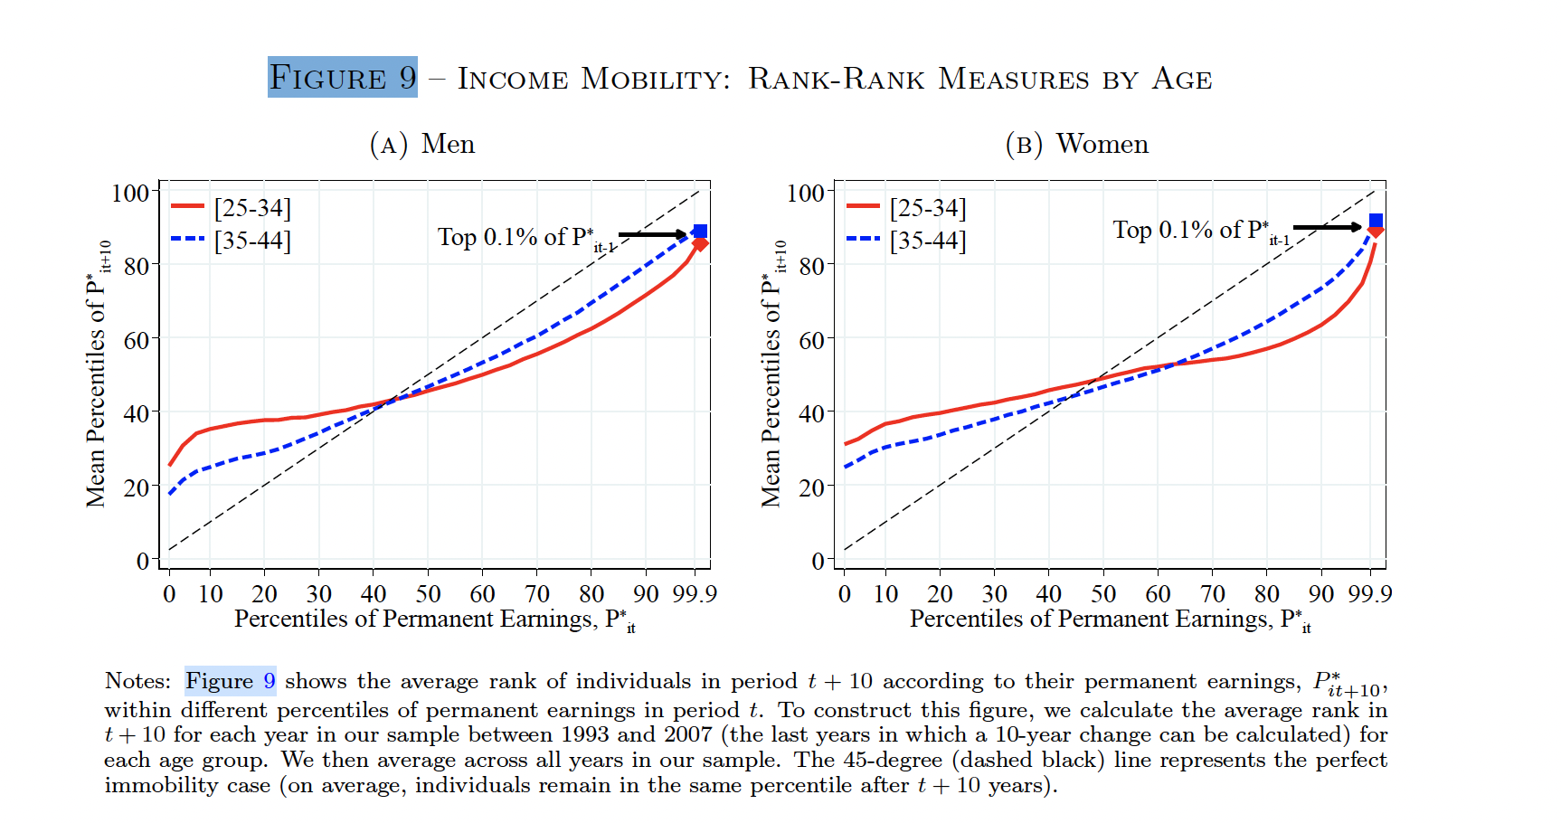
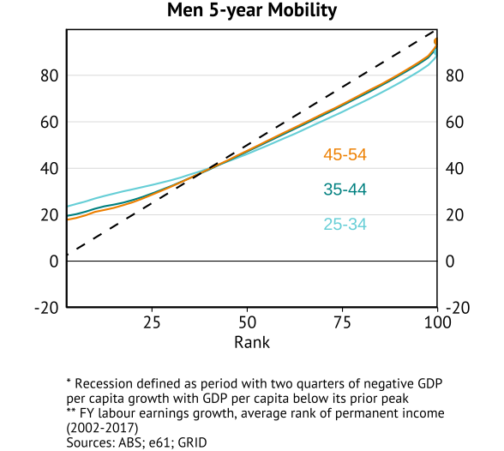
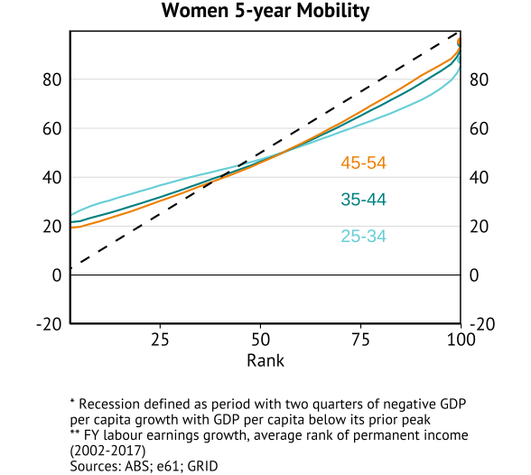
Rank-rank mobility within permanent income distribution

Slide 18
Appendix

Slide 19
Data construction
Start with a LEED file based on business tax reporting and household tax returns:
Collapse wage income across all firms in each financial year
If PAYG value is missing, use value from Individual Tax Return
Merge in demographics file
Sample in focus:
Individuals aged between 25 and 55
Individuals with meaningful attachment to the labour force who earn above a cutoff: working full time for at least one quarter of year at the national minimum wage

Slide 20
Insert table 1 from grid paper for whats available in the AUS data

